Slide 1
Interplay between epidemic and information spreading
A Life Data Epidemiology project
by Erica Brisigotti & Anna Garbo

Slide 2
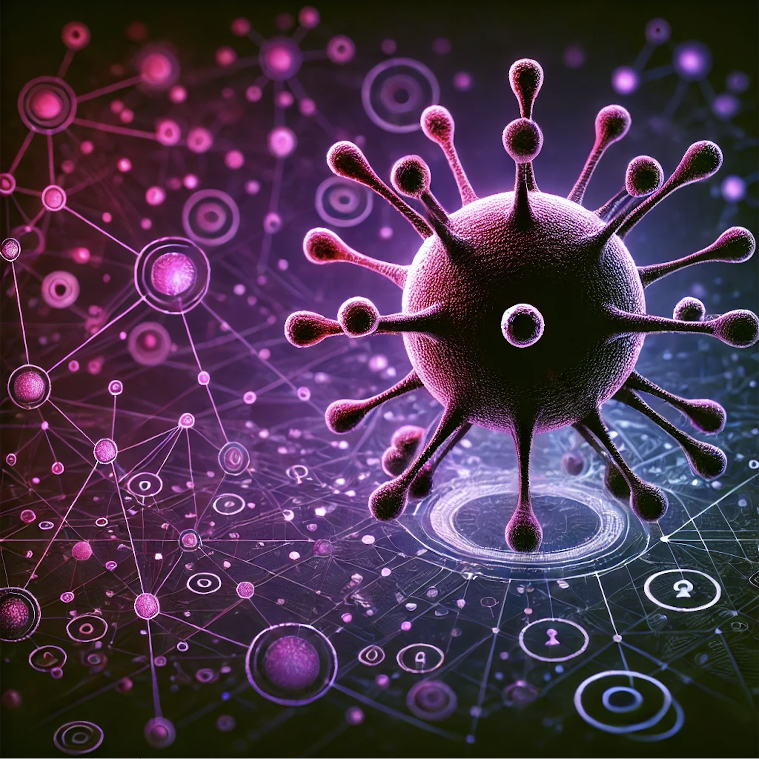
Overview
context to the problem
project objective
model & hypothesis
dynamics
simulation
evaluation techniques
results
conclusions
future prospects
Immagine generata con Intelligenza Artificiale generativa

Slide 3
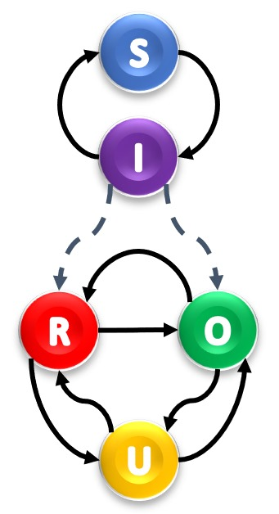
Understanding the problem
[Chou et al., 2020; Roozenbeek et al., 2020]
Epidemic spreading
Information spreading
Disease spreading is based on biological and social mechanisms, and involves two states:
susceptible S
infected I
Information spreading depends on social interactions, and involves three states:
official info O (by public institutions)
rumors R (by unverified sources)
uninformed U
Notes:
metterei a destra lo schemino degli stati nella 2 layer network

Slide 4
Understanding the problem
[Chou et al., 2020; Roozenbeek et al., 2020]
Effects of rumours
Effects of official info
Effects on the behaviors
Dangerous rumours and misinformation can lead to lead to mischaracterizing and/or undermining the severity of the epidemic
Official information can guide the public towards more effective epidemic prevention
Accurate information can improve public health behavior whereas misinformation can lead to risky behaviors.

Slide 5
Project Goal
If the individual's exposure to types of information influences their behaviour towards the epidemic, how is the size of the epidemic impacted?

Slide 6
Model
Compartmental Model for both Information and Health states
Scale-Free Network based on Barabasi-Albert model
Multilayer Network describing both Epidemic Dynamics and Information Dynamics
Notes:
aggiungerei anche qui, sotto model, il grafico schematico degli stati

Slide 7
Hypothesis
[Chou et al., 2020; Roozenbeek et al., 2020]
SIS Epidemic Dynamic
Susceptible (S) → Infected (I) → Susceptible (S)
Unaware-Aware-Unaware Communication Dynamic for both type of information
individuals are by default U and can become aware of information (O/R) but can also forget about it
p(I|O) < p(I|U)
O adopt behaviors that decrease the risk of infection
p(I|R) > p(I|U)
R adopt behaviors that increase the risk of infection
Notes:
metterei a sinistra, in verde, il concetto,

Slide 8
Simulation Dynamics
[Chou et al., 2020; Roozenbeek et al., 2020]

Slide 9
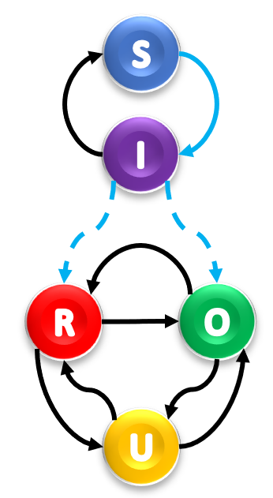
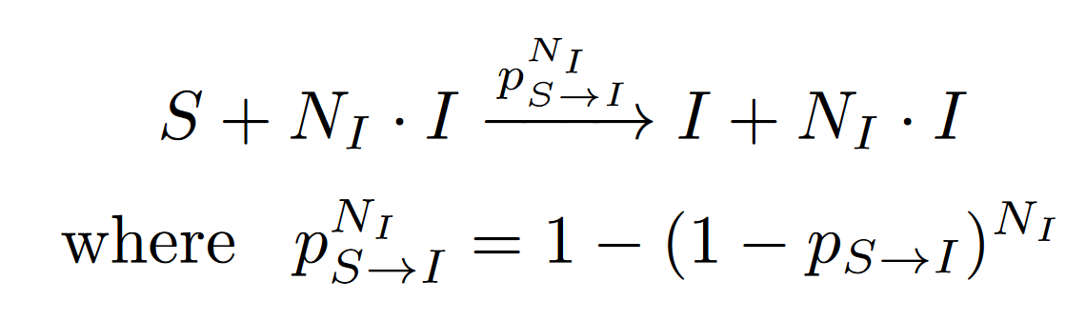
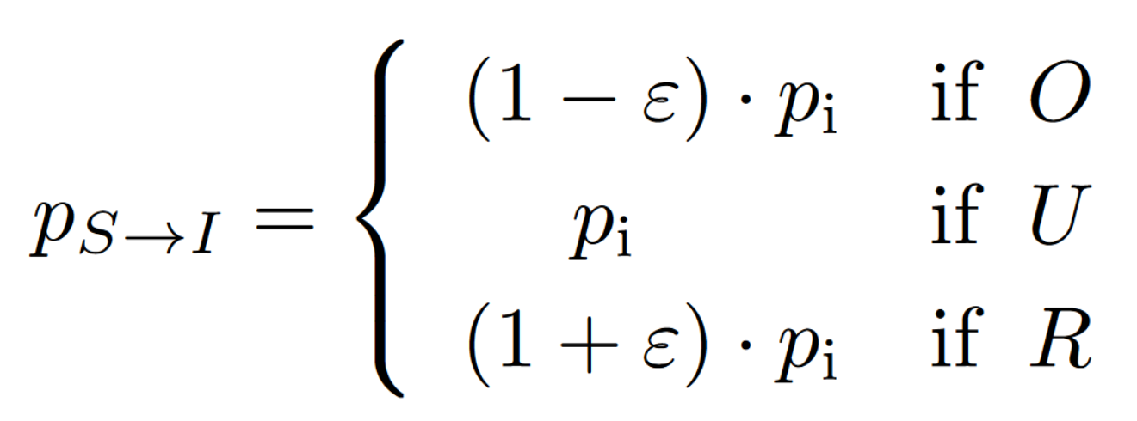
Disease Infection
is a contagious process and depends on the number of infected neighbours and on the node information state
forces the individuals to become aware of information (R or O) with the following re-normalized probabilities
Notes:
metterei a sinistra, in verde, il concetto,

Slide 10
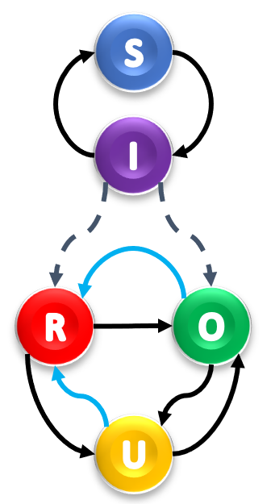
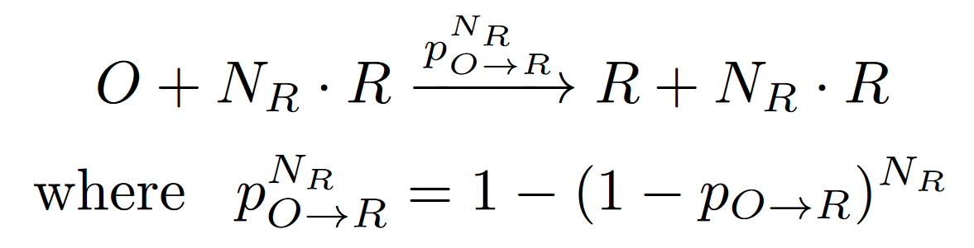
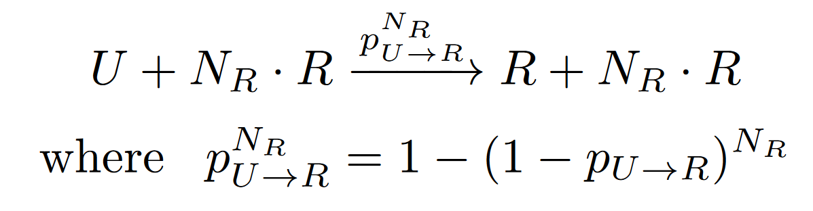
Rumour Infection
is a contagious process and depends on the number of rumour informed neighbours of the node
Notes:
metterei a sinistra, in verde, il concetto,

Slide 11
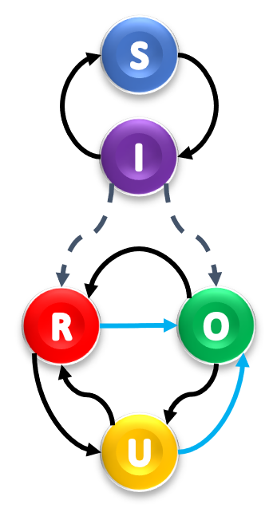
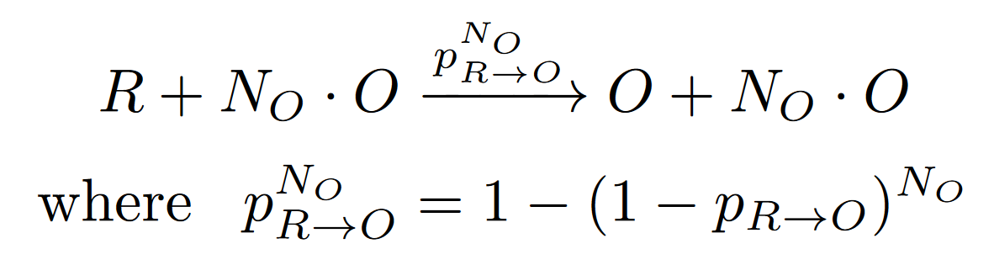
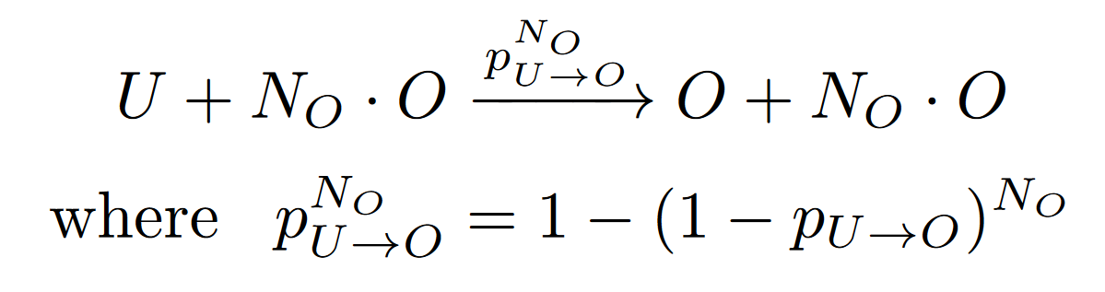
Official Infection
is a contagious process and depends on the number of officially informed neighbours of the node
Notes:
metterei a sinistra, in verde, il concetto,

Slide 12
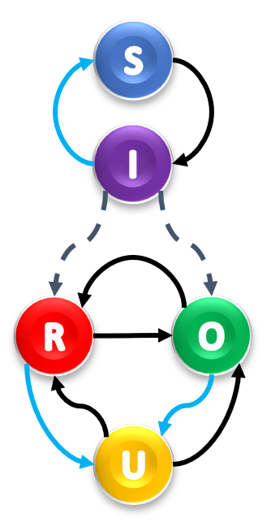
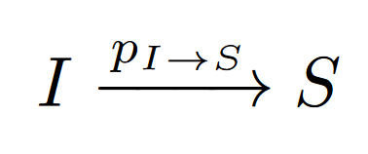
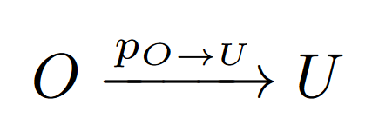
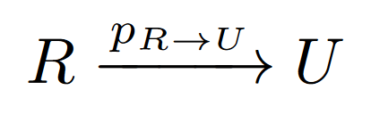
Recovery
Forgetting
is a spontaneous process (does not depend on the nodes’ neighbors)
is independent of the information status
is a spontaneous process
cannot happen while the node is infected
Notes:
metterei a sinistra, in verde, il concetto,

Slide 13
Simulation
was run on a large network of 2000 individuals
consisted of evolving the simultaneous spreading of the epidemic and information over 200 days
the number of individuals in each state (S, I, U, O, R) were saved at all times
the (final) attack rates were computed
the maximum number of newly infected was computed
was run for different values of its parameters to analyze their role
was run, for each combination of parameters, 100 times in order to evaluate a mean value and 95% confidence interval
in each analysis, only one or two parameters are changed at once, and the remaining ones are initialized to realistic values
Notes:
non so se ci sono altri parametri o se erano rimaste definitive queste simmetrie che avevo introdotto

Slide 14
Parameters
[Guess, A., Nagler, J., & Tucker, J. (2019). Misinformation and fake news exposure during the 2018 U.S. midterm elections. HKS Misinformation Review.]
p_U_to_O = 0.55 describes how likely a person is influenced by official information: we suppose an efficient official information spreading campaign and set a higher value
p_U_to_R = 0.35 as a consequence of an efficient campaign, we set a lower value
p_R_to_O is the probability of a person correcting themselves
p_R_to_U is the probability of forgetting rumours
p_O_to_U is the probability of forgetting official information so, in an efficient campaign, it should be low
p_O_to_R is the probability of an officially informed believing rumours and is non-null
m: number of edges to attach from a new node to existing nodes when building the network based on the Barabasi-Albert model
p_i is the disease transmission probability
R_0 = 2.5 is the basic reproductive number of the Covid19 disease
p_I_to_S: is the recovery probability and is computed based on the reproductive ratio number.
symmetric correction ε codifies the change of behaviour and susceptibility of an individual based on their information status

Slide 15
Evaluation techniques
Evolution of the Epidemic
shows the evolution of the simulation over time
shows the results of the simulations for different values a one parameter
the epidemic behaviour is quantified by computing the total number of infected at each time
Heat Maps
are used to explore the relationship between two parameters of the network, by varying their values
are useful to observe the impact of the information layer on the epidemic
the maximum number of newly infected in a day was chosen over the final attack rate as it showed more contrast

Slide 16
Results of the simulations

Slide 17
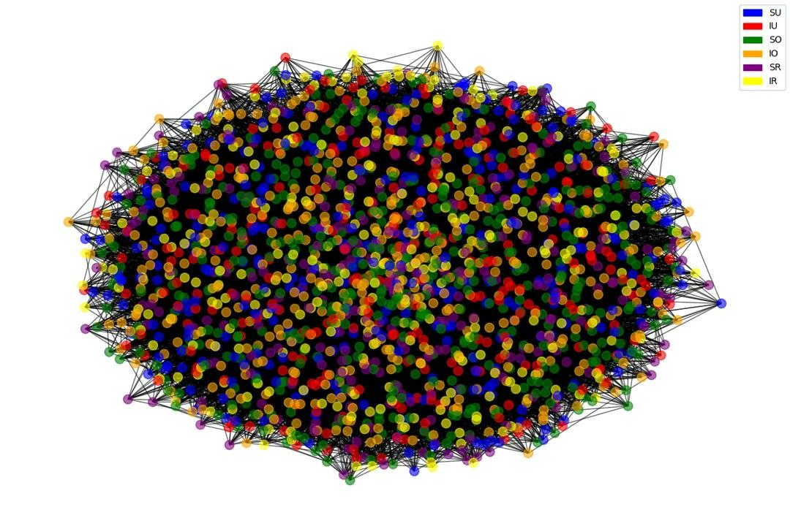
Recording: Example of nodes states evolving in time during the simulation.
Notes:
metterei qui il video della simulazione

Slide 18
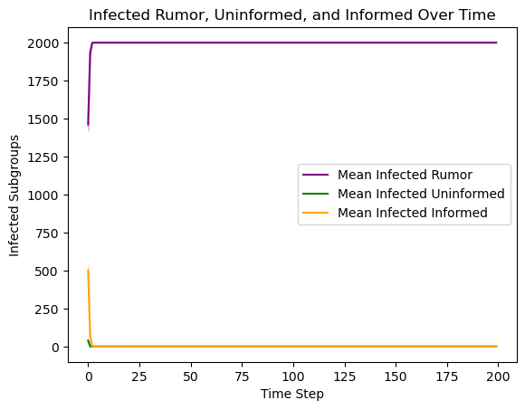
Informed density population evolution

Slide 19
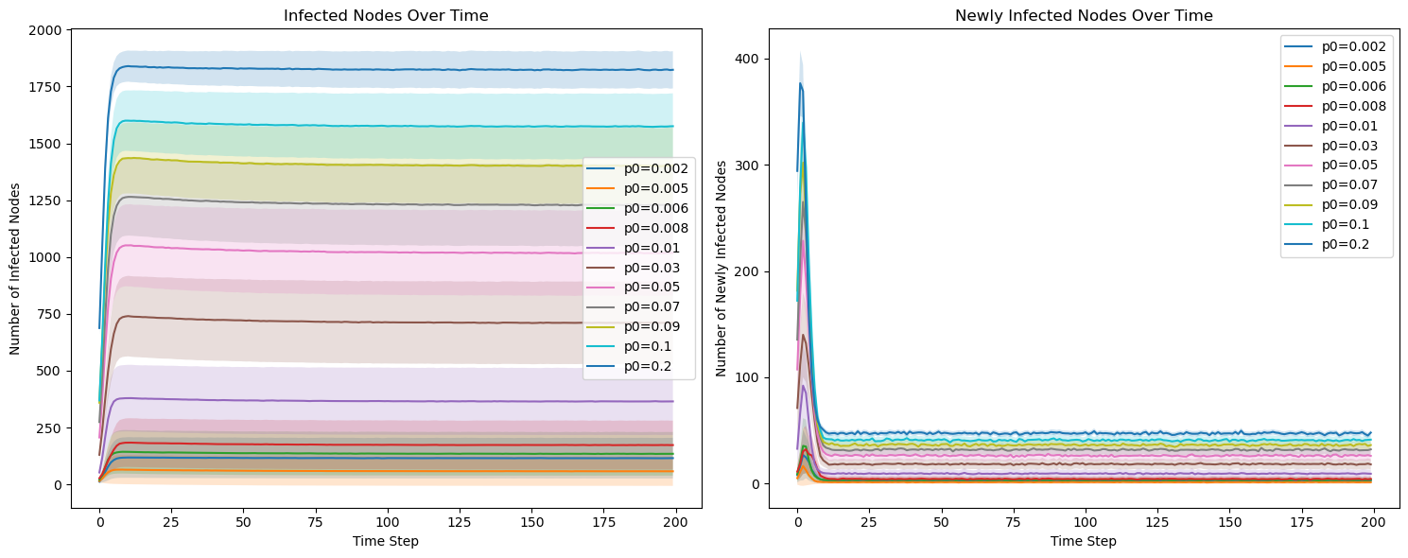
Minimum density of infected individuals to start the epidemic

Slide 20
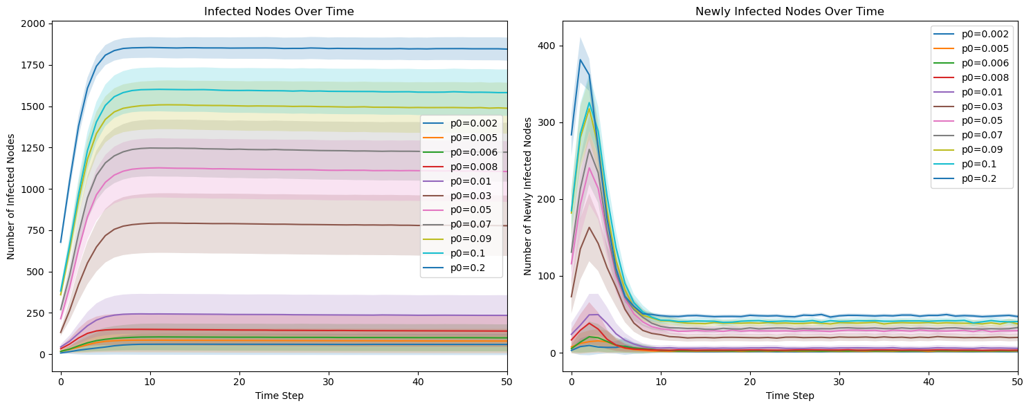
Minimum density of infected individuals to start the epidemic (zoom)

Slide 21
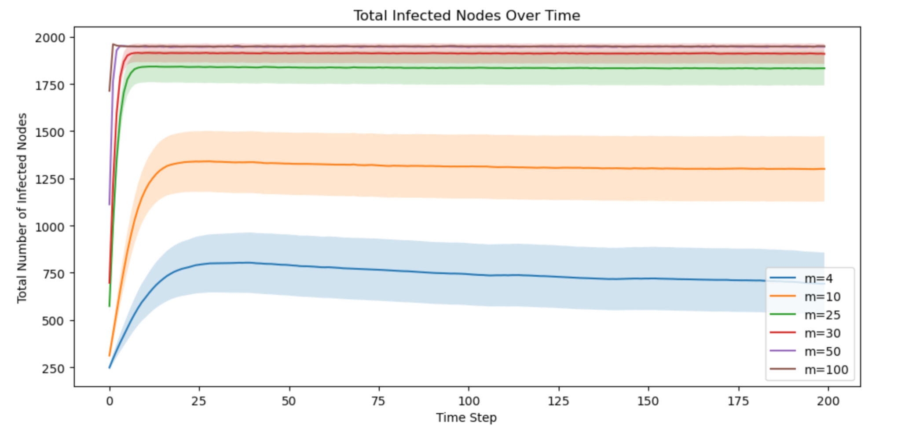
Connectivity: how it influences the spreading
Notes:
why total number if plotted over time step

Slide 22
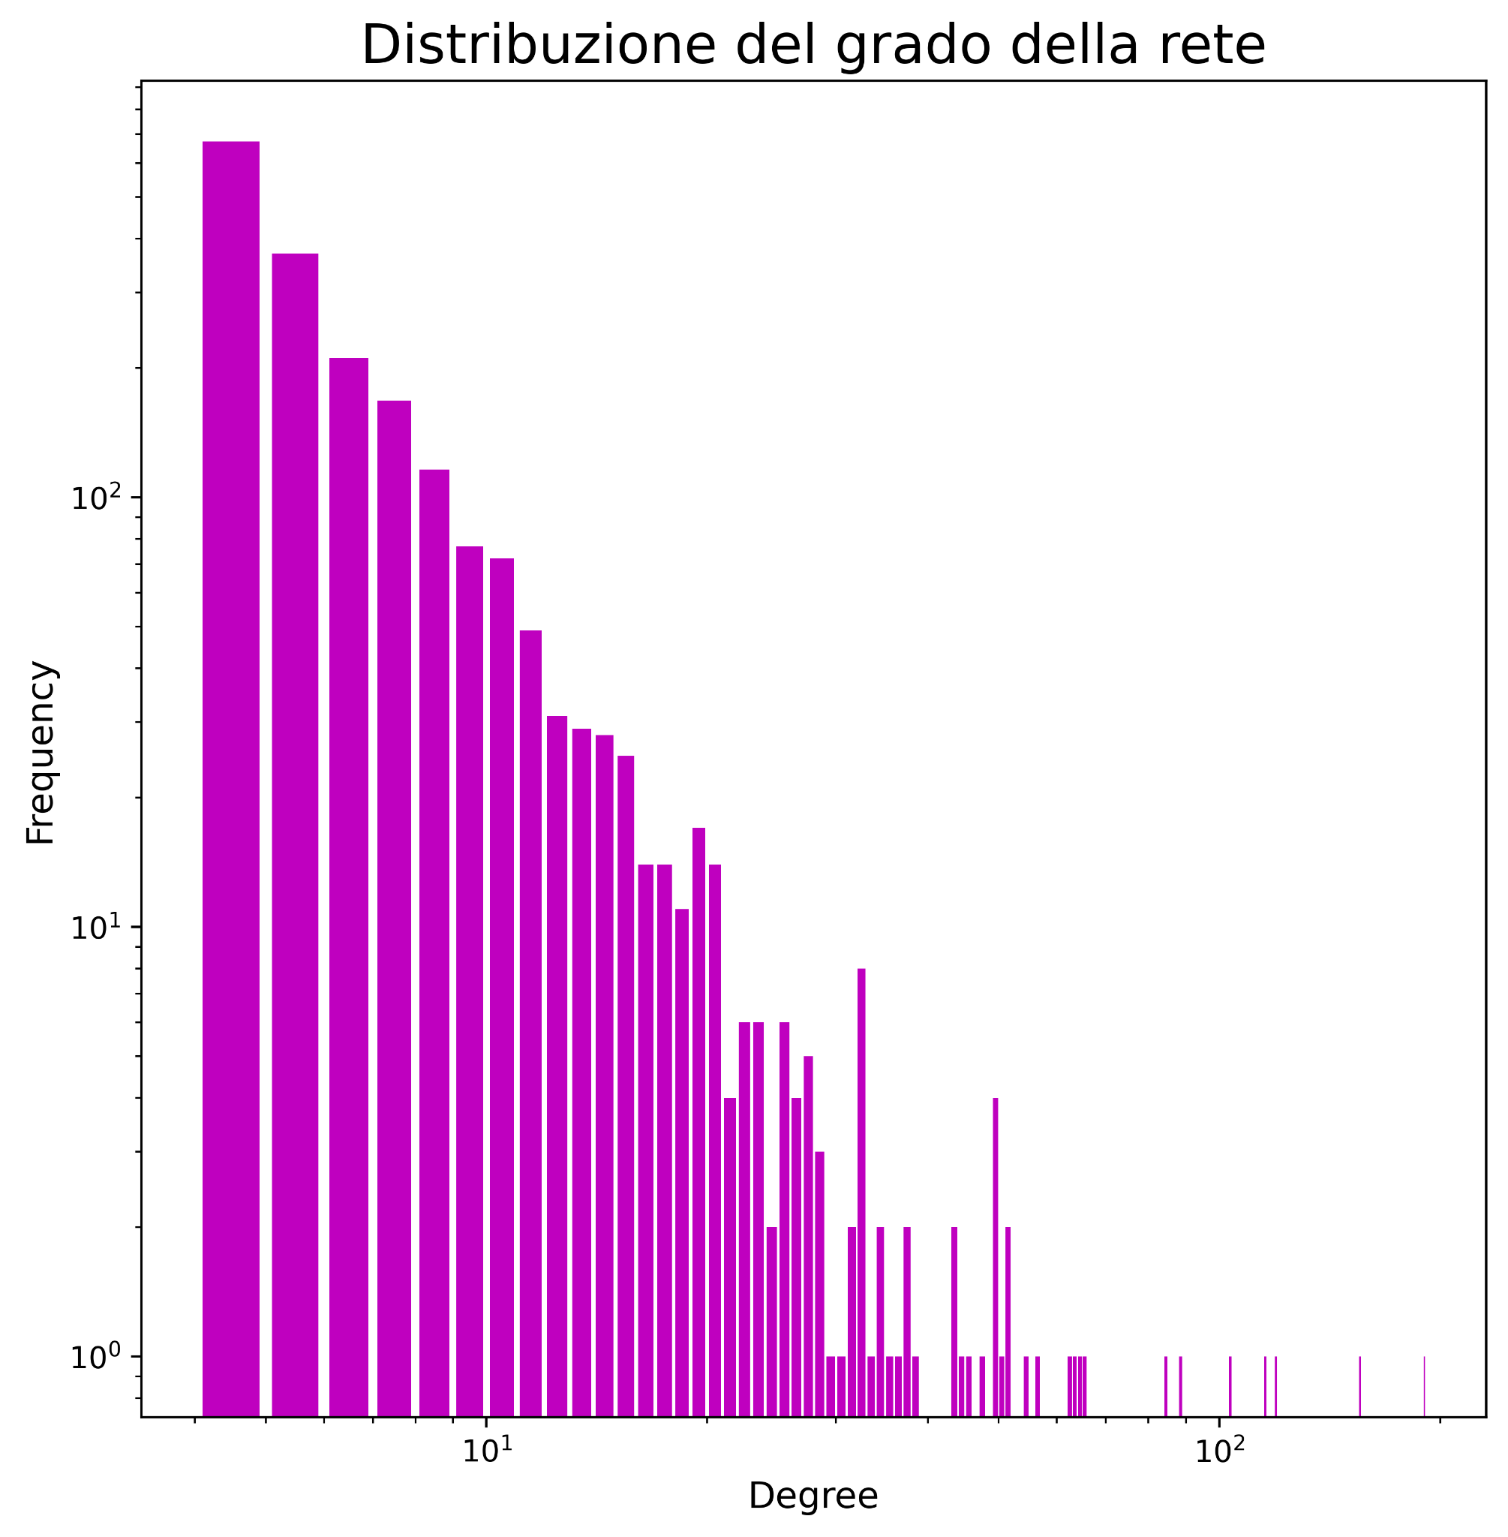
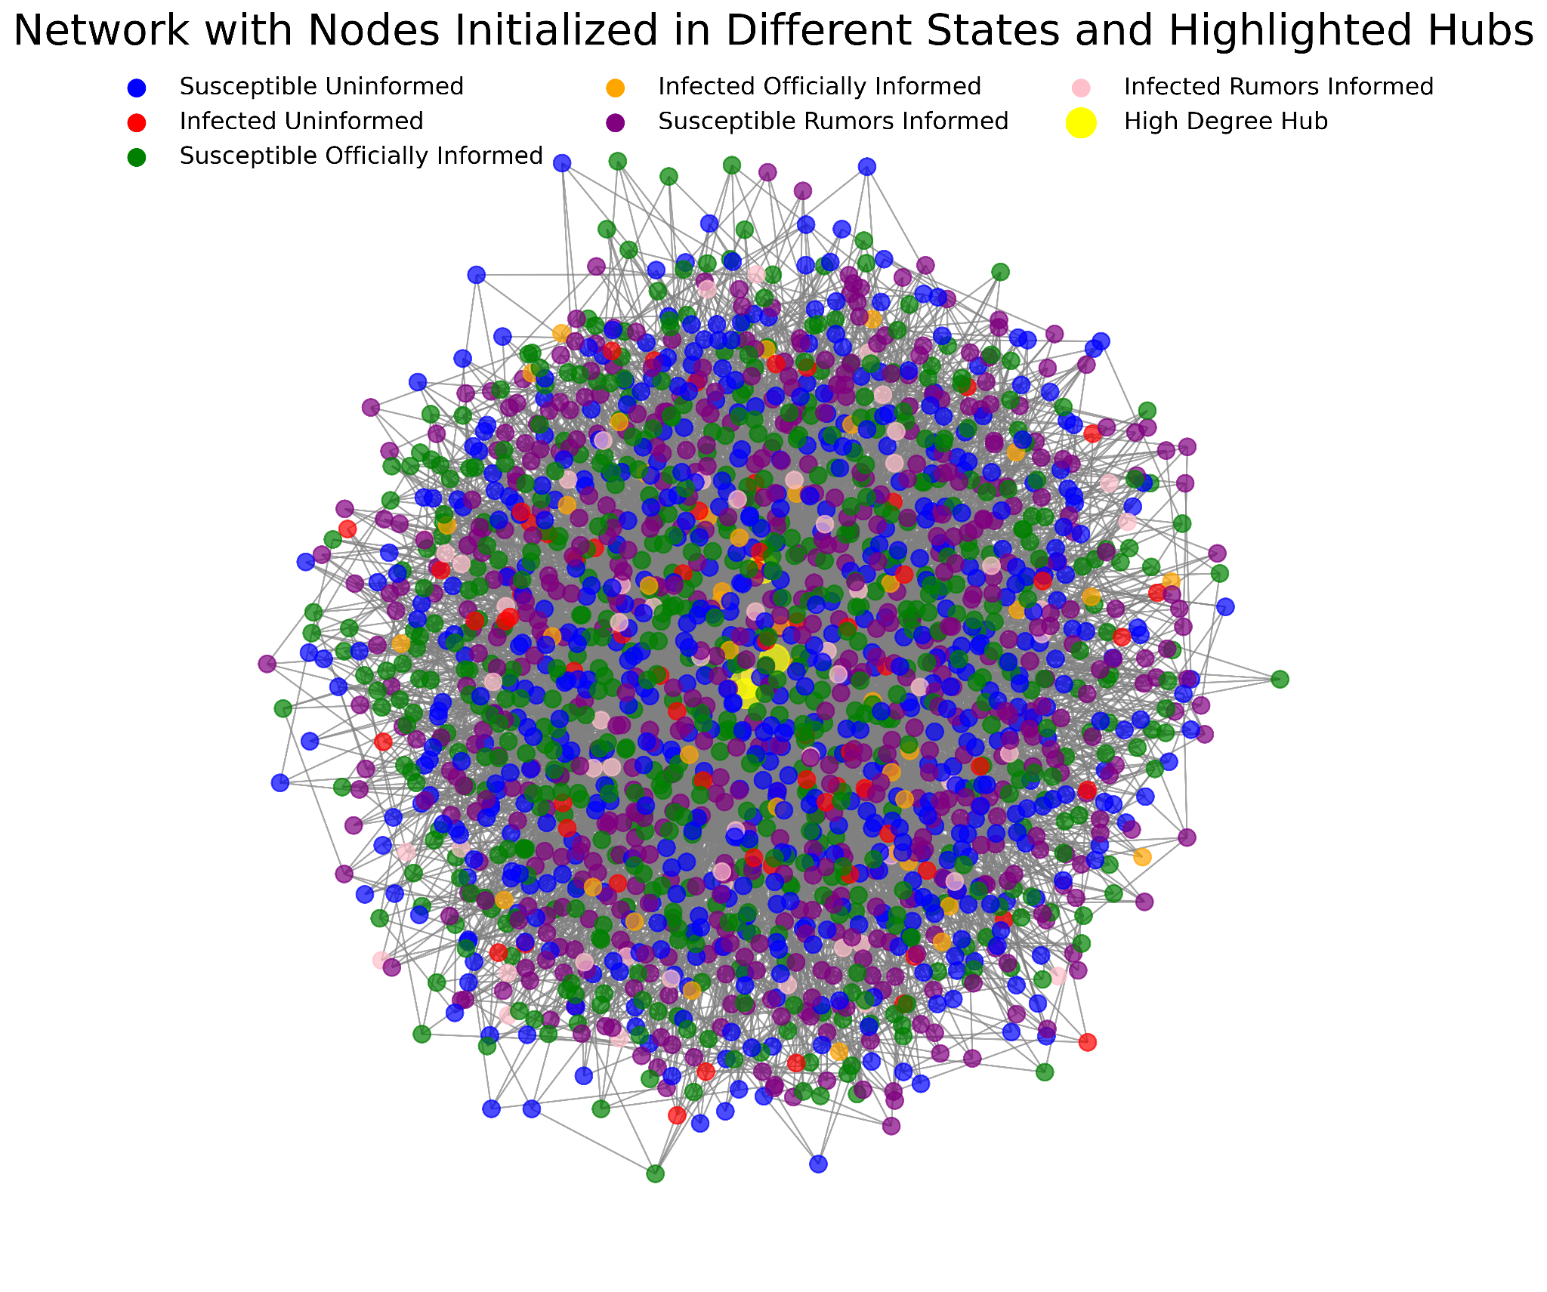
Targeted Infection of hubs as IR

Slide 23
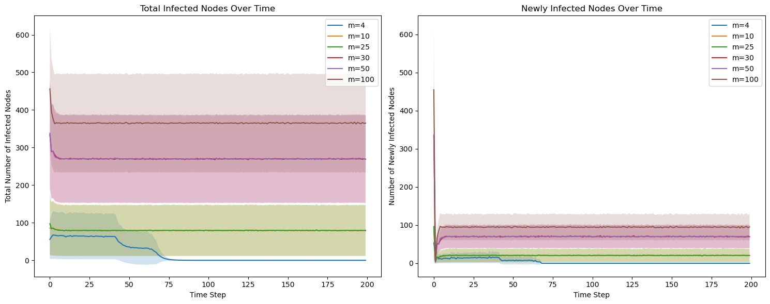
Target Infection: Only hubs get infected and rumor informed
Is this enough to start an epidemic?

Slide 24
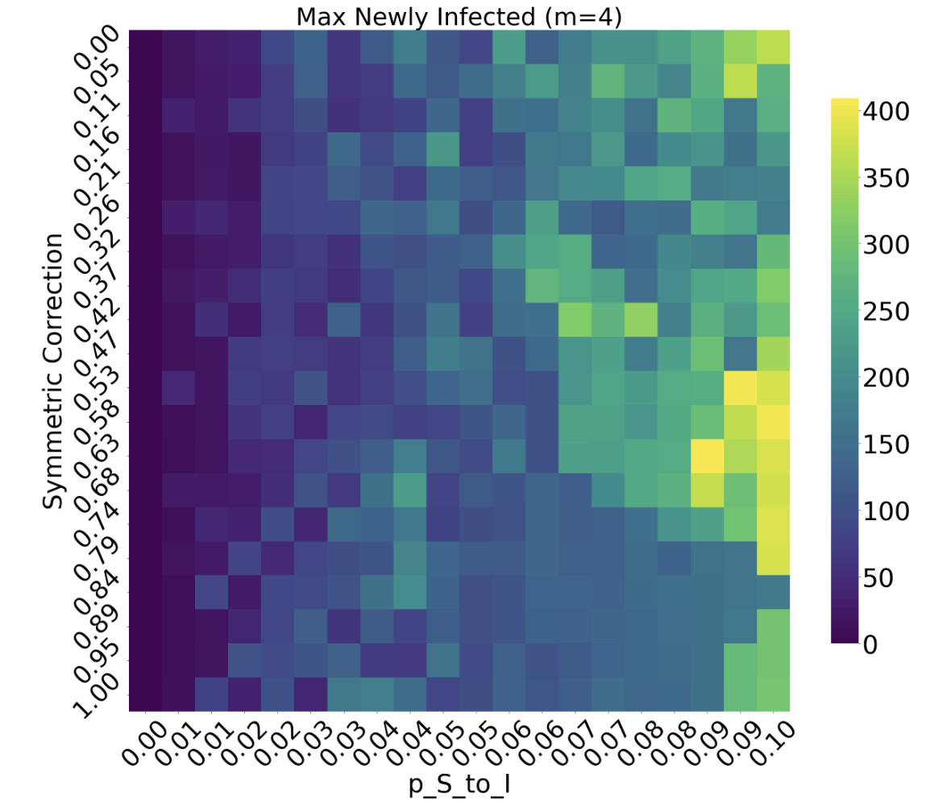
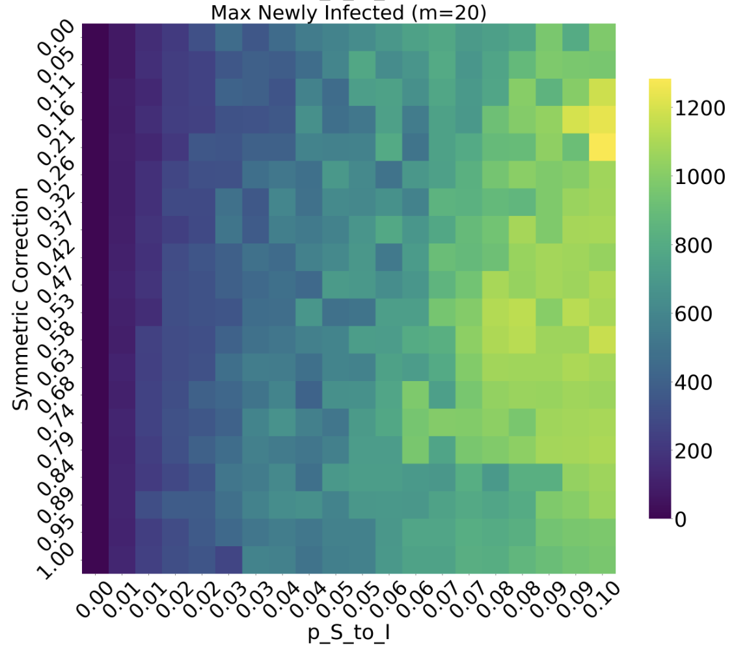
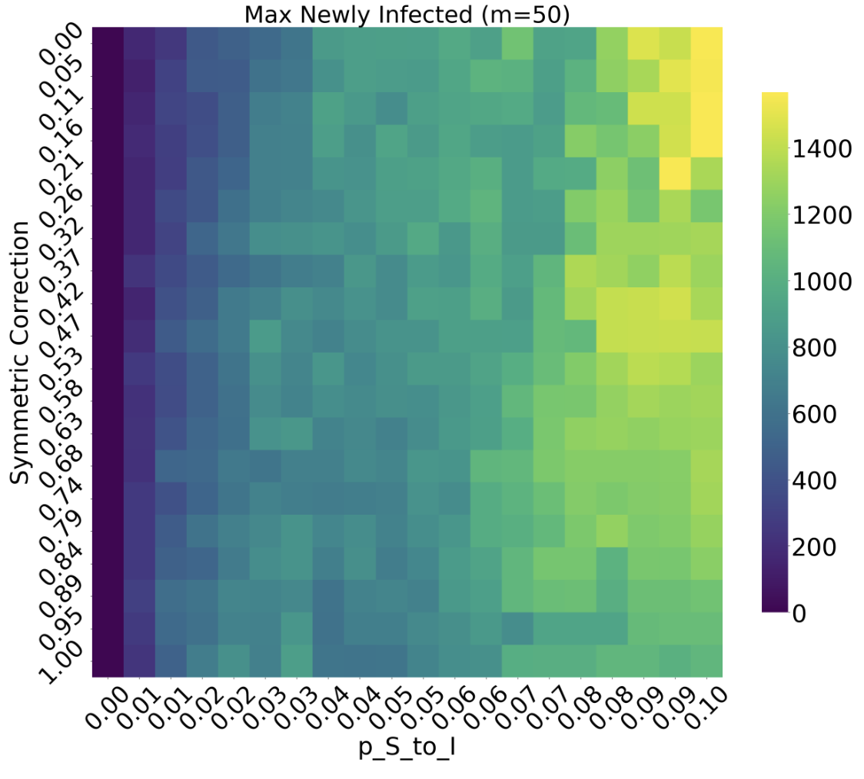
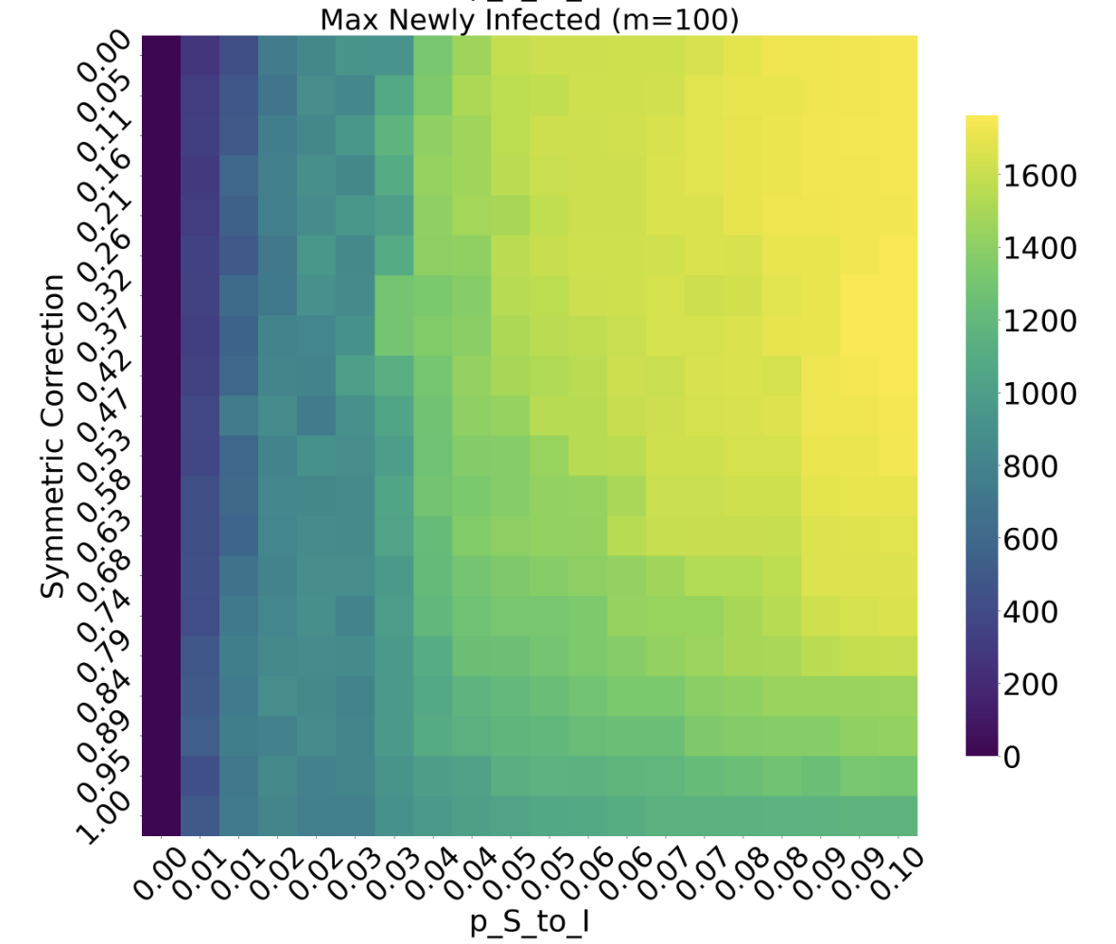
symmetric correction vs transmissibility
for many connectivities
symmetric correction contrasts the increase in trasmissibility, slowing down the spreading
the symmetric correction effect is
Notes:
Rimettere i plot con tanti valori

Slide 25
Conclusions
Observation 1
Observation 2
Observation 3
The symmetric correction, which means the capacity of information to influence people behavior, is a good instrument to contain the pandemic.
The connectivity of the network is a clear indication that reduce the contact between people is method to extinguish the epidemic.
Target infection for only hubs individual is not enough to start a pandemic, but we still believe that this are the individual that are more responsible of epidemic diffusion.

Slide 26
Future Prospect
Online Info Spreading
Level of Education
Age & Degree
Create a more realistic network by including online interactions, which can lead only to information contagion.
Make susceptibility to information (R/O) dependent on the level of education of the individual
Create a more realistic network by making the number of connections that a person/node has dependent on their age

